Slide 1

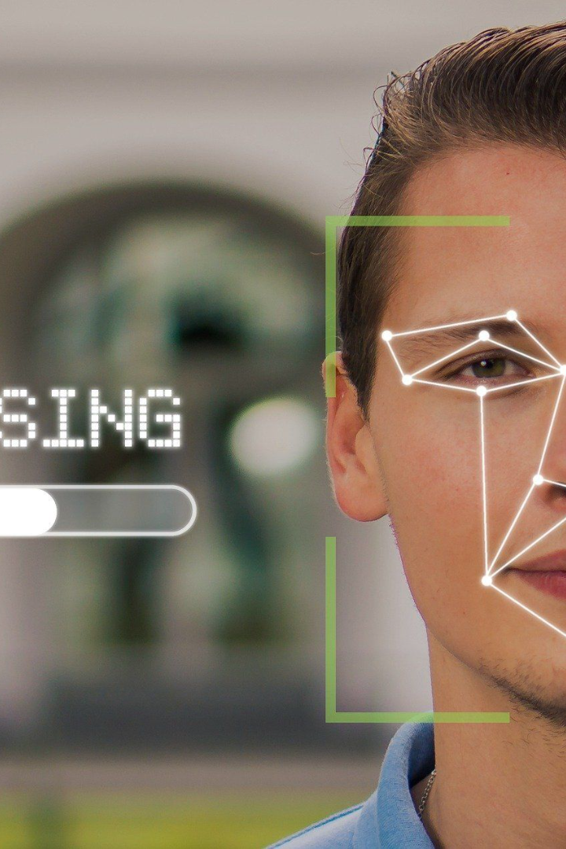
TruthSense: A Real-time Remote-Control Lie Detector
Final Year Project of:
Abdul Qadeer
Areeb Hassan
Muhammad Ali

Slide 2

Problem
The problem addressed in this project is a significant challenge faced during various scenarios such as interviews, interrogations, and investigations: distinguishing between truthful and deceptive responses. The available conventional methods are time taking, subjective, and their accuracy is doubted.

Slide 3

Related Work
The proposed methodology builds on existing research findings in lie detection and emotion recognition using facial analysis and physiological signals. Several studies have explored the relationship between facial expressions, physiological changes, and deception. Our project builds upon these findings to create a lie detection system that combines multiple signals with the hope for improved signal-to-noise ratio.
Barathi, C. S. (2016). Lie detection based on facial micro expression body language and speech analysis. Int. J. Eng. Res. Technol. 5, 337–343. doi: 10.17577/IJERTV5IS020336
Bartlett, M. S., Littlewort, G. C., Frank, M. G., and Lee, K. (2014). Automatic decoding of facial movements reveals deceptive pain expressions. Curr. Biol. 24, 738–743. doi: 10.1016/j.cub.2014.02.009
Beh, K. X., and Goh, K. M. (2019). “Micro-expression spotting using facial landmarks,” in Paper Presented at the 2019 IEEE 15th International Colloquium on Signal Processing and Its Applications (CSPA) (Penang).

Slide 4
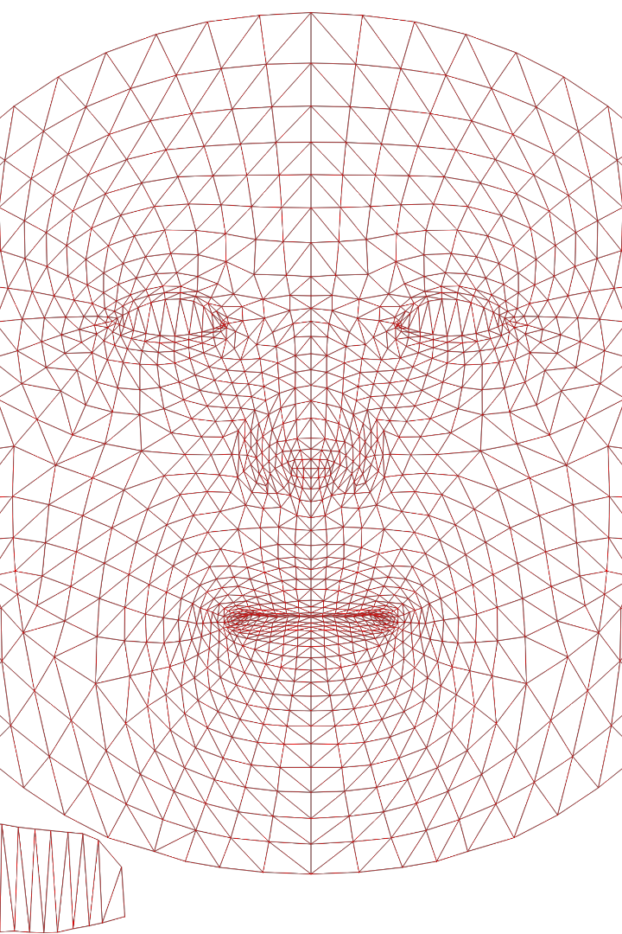
Proposed Methodology
Develop real-time remote-controlled lie detector app using facial analysis and physiological signals.
Utilize OpenCV and trained Face Mesh model for facial landmark detection from video input.
Extract facial movement and expression data for analysis.
Incorporate model for mood detection via facial expressions, adding emotional context.
Analyze physiological signals like heart rate, blink rate, gaze, hand gestures, and lip compression.
Compare signals to individual's baseline to spot significant changes hinting at deception.
Extensive testing and evaluation to validate real-time performance and accuracy.

Slide 5

Expected Results
Real-time lie detector app with enhanced accuracy in discerning truthful and deceptive responses.
Fusion of facial analysis and physiological signals for dependable lie detection results.
Integration of remote-control feature for user convenience.
Focus on user-friendly interface for transparent real-time feedback.
Thorough testing and evaluation to confirm real-time performance and accuracy.

Slide 6

Technology Used in TruthSense
Utilizes computer technologies including OpenCV, trained Face Mesh model, and facial expression detection.
Detects facial landmarks, expressions, and mood for deception indication.
Real-time remote-controlled functionalities for user convenience.
Python programming language employed in the development.
Ongoing research to explore and integrate new technologies for solution enhancement.

Slide 7

Pros
Cons
Enhanced Deception Detection: Combining facial analysis and physiological signals for potentially improved accuracy.
Real-Time Feedback: User-friendly interface provides immediate information for decision-making.
Remote-Control Functionality: Users can manage the process from a distance, adding convenience.
Innovative Approach: Integrating multiple technologies for advancements in lie detection.
Accuracy Challenges: Potential for false positives or negatives due to the complexity of analysis.
Reliability and Validation: Extensive testing and maintenance required for consistent performance.
Complex Implementation: Integrating various technologies may be technically challenging.
Human Interpretation: Human analysis remains crucial for accurate interpretation.
Ethical Concerns: Considerations about impact on individuals' rights and legal system.

Slide 8

Impact of TruthSense
The impact of "TruthSense" in the real world could be profound. It has the potential to revolutionize deception detection in legal settings, augment communication in personal relationships, and enhance negotiation dynamics in business. Moreover, its application in therapy, journalism, and international relations could lead to improved accuracy, trust-building, and conflict prevention. However, ethical considerations and responsible implementation remain pivotal to harness its benefits while safeguarding individual rights and privacy.

Slide 9

Future Research
Future research on "TruthSense" could focus on refining the lie detection algorithm by integrating more advanced machine learning techniques. Exploring ways to reduce false positives and negatives will be crucial for enhancing accuracy. Additionally, investigating the system's adaptability across diverse cultural and linguistic contexts could expand its applicability. Long-term studies assessing the psychological and ethical implications of using such technology for truth verification could provide valuable insights. Lastly, collaborations with experts in psychology, human behavior, and legal fields could contribute to a holistic understanding of the technology's potential and limitations.

Slide 10

Conclusion
The "TruthSense" project proposes an innovative methodology for a real-time remote-controlled lie detector application, combining facial analysis and physiological signals to enhance truth verification processes. It prioritizes accuracy, user-friendliness, and data privacy to provide a reliable tool for deception detection. The remote-control functionality empowers users to monitor and control the lie detector from a distance, offering flexibility during lie detection scenarios. Our project promises to deliver a highly accurate and user-friendly lie detector application, empowering users with a reliable tool for deception detection. Ultimately, the "TruthSense" project contributes to advancements in the field of lie detection, promising broader applications and potential for enhancing truth verification processes in various professional settings.

